Slide 1
Impact-based ensemble forecasting of tropical cyclones
Yohei Sawada
The University of Tokyo
Special thanks to:
Le Duc, Futo Tomizawa, Mai Hung, Yuki Hirose, Kazuo Saito, Md. Rezuanul Islam

Slide 2
1. Introduction

Slide 3
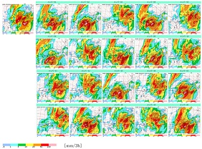
1.1. Ensemble forecasting opens the door to impact-based forecasting
JMA’s Mesoscale ensemble prediction system
(MEPS)
Sensitivity -> hard to predict severe events
prediction
truth
prediction
truth

Slide 4

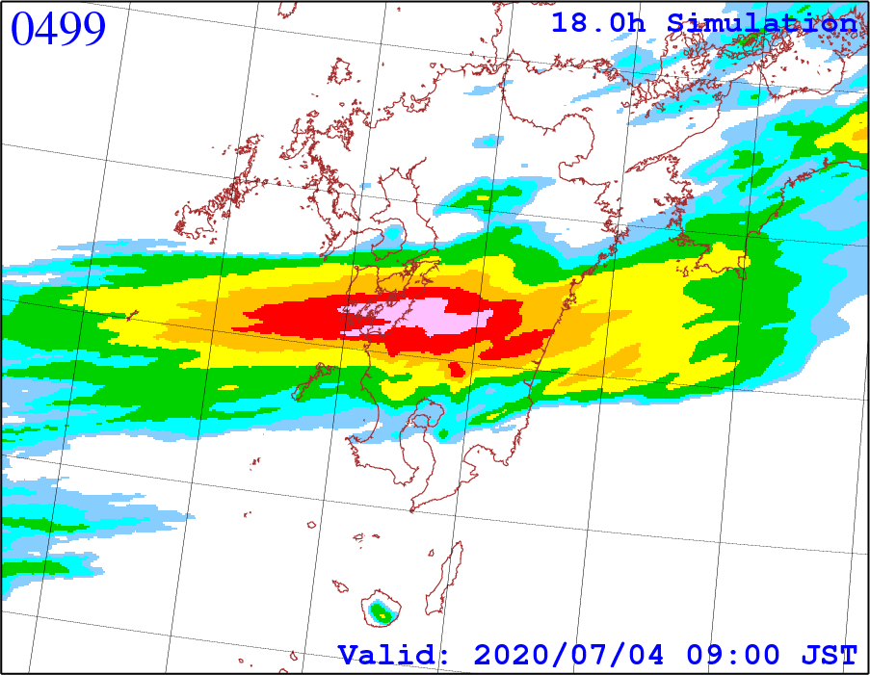
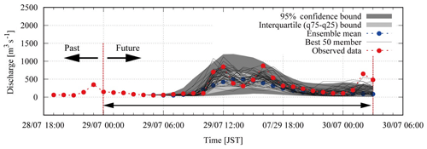
1.2. “Huge” ensemble forecasting: forefront of the NWP science
1000-member ensemble forecast by Fugaku supercomputer
Put them to river model
“Huge” ensemble impact forecasting
[Duc et al. 2021 SOLA https://doi.org/10.2151/sola.2021-007]
[Kobayashi et al. 2020 NHESS https://doi.org/10.5194/nhess-20-755-2020]

Slide 5
1.3.1. Challenges in ensemble forecasting toward impact-based forecasting (1)
Are you using ensemble data operationally?
Orange：Regularly use, Red：Not available but would like to have, Blue：Not available or required
[Titley et al. 2019 Tropical Cyclone Research and Review
https://doi.org/10.1016/j.tcrr.2019.10.005]
More impact-based

Slide 6

1.3.2. Challenges in ensemble forecasting toward impact-based forecasting (2)
Challenge 1
How to generate “good” ensemble by explicitly considering all the relevant uncertainties in an efficient way?
All the ensemble could not capture observation very well…
Challenge 2
How to effectively use ensemble in an operational timeframe?
ensemble mean?
Scenario analysis?

Slide 7
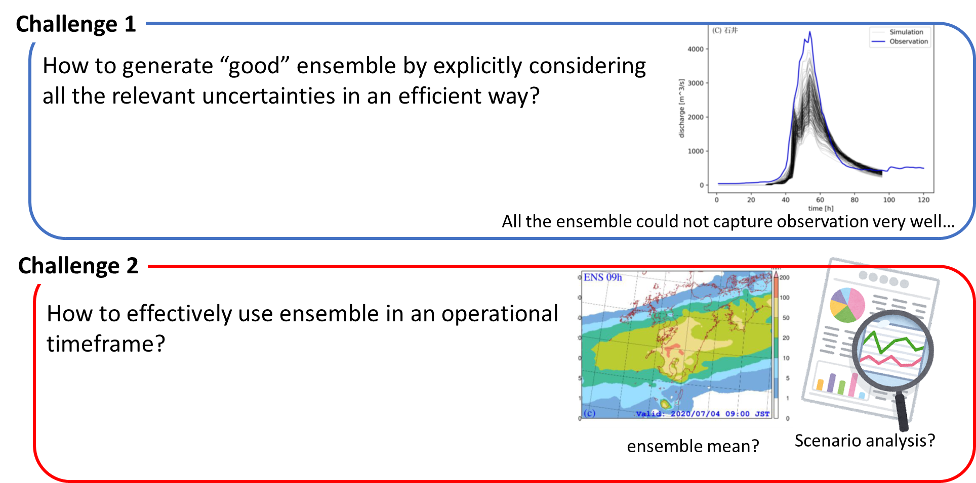

2. Challenge 1: quantifying all the relevant uncertainties in ensemble forecasting

Slide 8
2.1. Goals
Atm. Model
Dynamic Core
Probabilistic!
Function call
Current
state
Future
State
Op.1
Op.2
Op.3
Op.1
Op.2
Op.3
Op.1
Op.2
Op.3
…
Cumulus
Cloud
Radiation
Selection of parameterization
Deterministic or expert knowledge….
Para. 1
Para. 2
Para. 3
Selection of parameters
Observation data
We would like to get ensemble of selected parameterization and parameters based on observation efficiently and objectively to quantify all relevant uncertainties.

Slide 9




2.2.1. Key ideas (1): Blended parameterization
Blended Model
[Mai et al. 2020 HESS]
Instead of choosing a scheme, we call all schemes to calculate weighted mean of increment of state variables. Then, we optimize weights as parameters
→ We can simultaneously solve scheme selection and parameter optimization as optimization problem of continuous variables.
→ It is expected to increase model performances by integrating several schemes.
Dyn. Core
Dyn. Core
Op.1
Op.2
Op.3
Op.1
Op.2
Op.3
Cloud
Cloud
$$\frac{dx}{dt}=f(x,Op.1)$$
or
$$\frac{dx}{dt}=f(x,Op.2)$$
$$\frac{dx}{dt}=w_{1}f\left(x,Op.1\right)+w_{2}f\left(x,Op.2\right)+w_{3}f\left(x,Op.3\right)$$
or
$$w_{1}+w_{2}+w_{3}=1$$
$$\frac{dx}{dt}=f(x,Op.3)$$
Parameters！

Slide 10
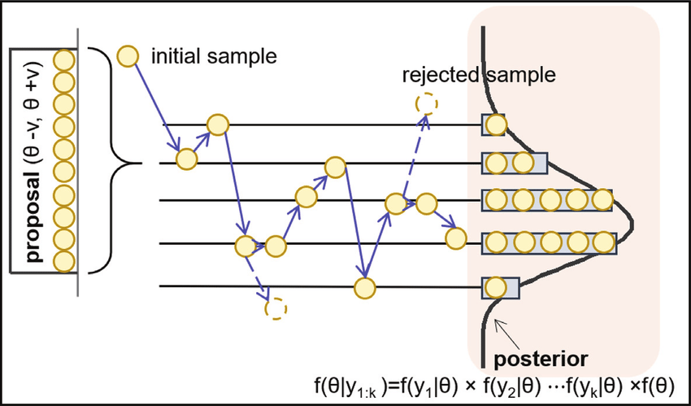
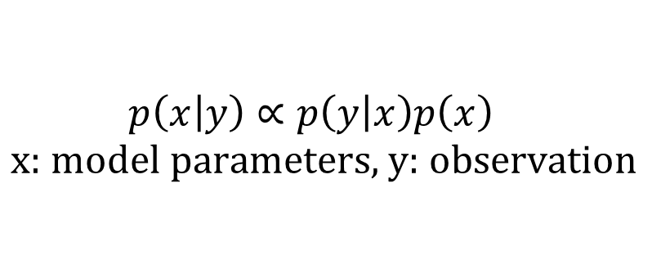
2.2.2. Key ideas (2): Efficient parameter optimization with machine learning
Global Sensitivity Analysis
Bayesian inference
$$p\left(\left.x\right|y\right)∝p\left(\left.y\right|x\right)p\left(x\right) \\ \text{x}\text{: }\text{model} \text{parameters}\text{, }\text{y}\text{: }\text{observation}$$
Evaluate the sensitivity of parameters to observation
→ Focusing only on sensitive parameters!
Machine learning-based surrogate model
Parameters
Statistical model
Dynamic model
[Dong et al. 2019]
Although we must iteratively evaluate model parameters, we can avoid running an atmospheric model using machine learning based surrogate models.
Output
Accelerate the iterative processes of parameter optimization.

Slide 11
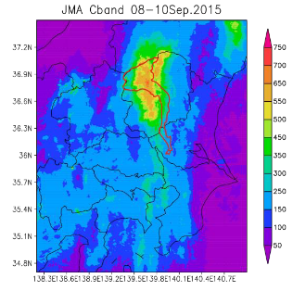
2.3.1. Case study 1: 2015 Typhoon Kilo and Etau
In 2015, more than 600mm rainfall hits Kanto and Tohoku regions due to quasi-linear rainband induced by two tropical cyclones.
The levee collapsed in Kinu river affecting a number of people.
Atmospheric model: WRF [Scamarock et al. 2008]
Enabling 33 parameters to be optimized, which include the selection of parametrizations. Parameters are optimized by radar-based rainfall.
River inundation model: RRI [Sayama et al. 2012]
Evaluating the skill to forecast river discharge.
[Ushiyama et al. 2017]

Slide 12
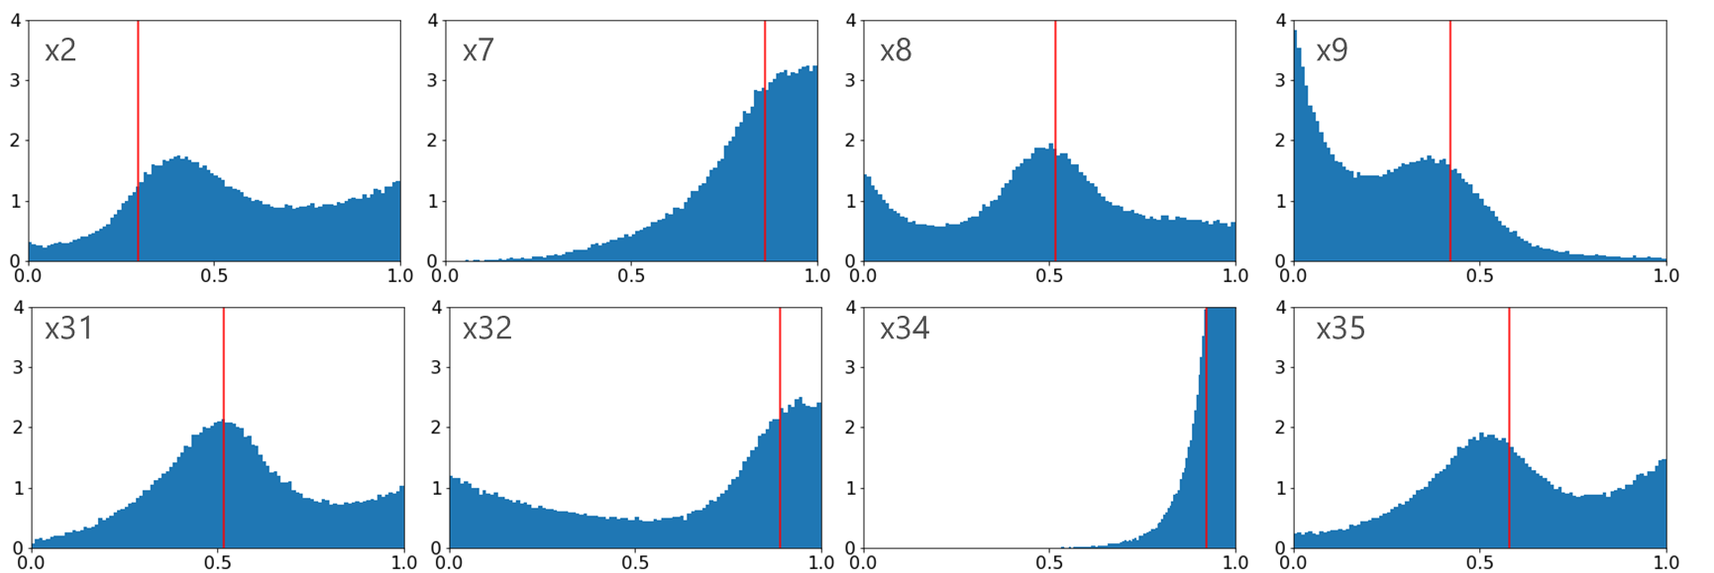
2.3.2. Parameter optimization.
Optimization results of 8 sensitive parameters (from total 33 parameters)
Red: Truth, Blue: Posterior probability density
[Tomizawa et al. in prep]
(This is an idealized experiment)
We can effectively constrain sensitive parameters by our method.
But large uncertainty remains (i.e. observation could not perfectly determine parameters).
Ensemble that samples this uncertainty is really necessary!

Slide 13
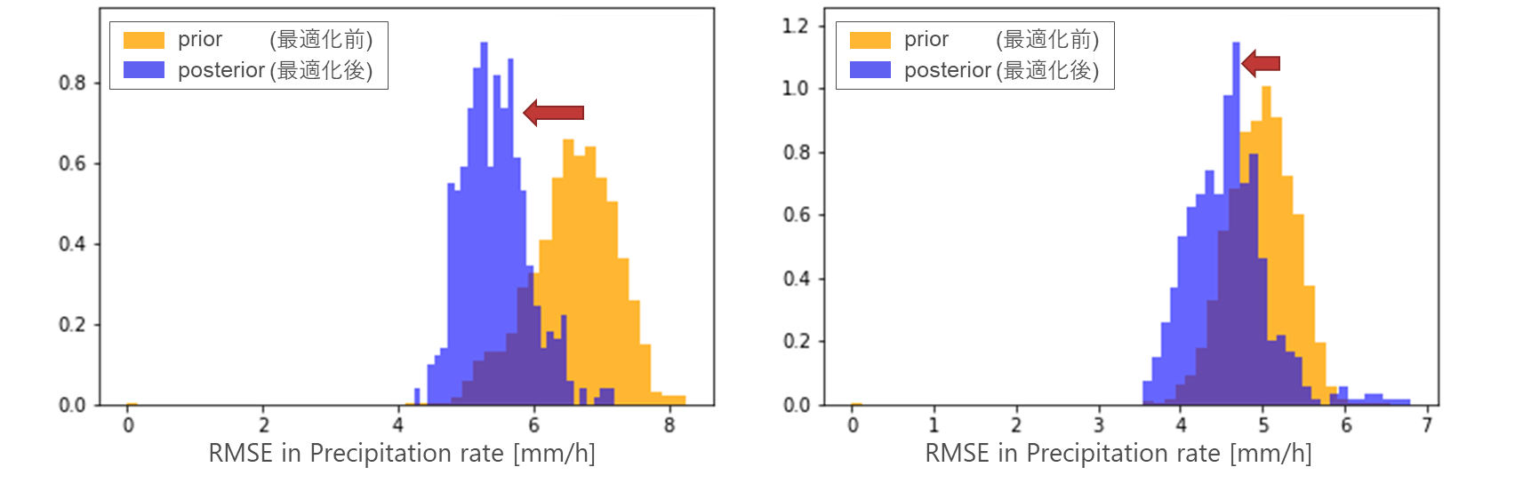
2.3.3. Rainfall prediction
0h
24h
36h
present
time
Training period
Rainfall RMSE against Radar-AMDAS
Rainfall RMSE against Radar-AMDAS
[Tomizawa et al. in prep]
Our optimized parameter improves future rainfall simulation!

Slide 14
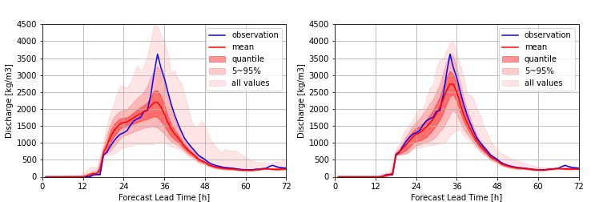
2.3.4. Flood prediction
River discharge simulation at Kinu river
present
present
[Tomizawa et al. in prep]
Our optimized parameter improves future river discharge simulation!
→ All optimization process can be done less than 2-hour. Our proposed ensemble generation is computationally feasible.

Slide 15
2.4.1. Case study 2: Multi-physics Ensemble prediction in Viet Nam
Application to Viet Nam Operational Ensemble prediction system
Viet Nam has already operated the 32-member ensemble prediction system in which each member choose 1 from 2⁵ = 32 combination of parameterization from 5 physics component.
→ “Blended” parameterization is applied and optimized by rainfall observation.

Slide 16
2.4.2. Case study 2: Preliminary results
Ensemble mean rainfall
Ensemble mean rainfall
Dyn. Core
Dyn. Core
Op.1
Op.2
Op.3
Op.1
Op.2
Op.3
Cloud
Cloud
Our new 32-member system eliminates the spurious rainfall. In addition, we can get a larger spread of rainfall forecasting, which potentially reduces the probability to fail strong rainfall.

Slide 17

3. Challenge 2 (PART I): Is ensemble mean beneficial?

Slide 18
3.1. Value of ensemble mean prediction
Radar-observed rainfall
JMA’s deterministic
JMA’s ensemble mean
[Duc and Sawada 2024 JMSJ]
Ensemble mean is one of the reasonable choices to represent ensemble members.
But.. For many relevant variables to impact-based forecasting, ensemble mean is useless (in the case of small ensemble sizes)

Slide 19
3.2. Why is ensemble mean of precipitation so bad?
Consider 1-D world, and there are two ensemble members of rainfall distribution (Green)
Let’s identify the “center” of these two members.
Ensemble mean suggests the blue line as a center, which is something wrong….
1-D world
We could not get the red line as a center of two members when using arithmetic mean.
Can we define another “mean” to get red line?

Slide 20

3.3. Key idea: Using optimal transport theory
To obtain “center”, we implicitly define “distance”.
We should change the definition of “distance”.
“Distance” in arithmetic mean
Sum of difference in pixel by pixel gives us “distance”.
“Distance” in optimal transport theory
The cost of moving one data to the other give us “distance”.
→ Wasserstein distance

Slide 21
3.4. New mean based on “Wasserstein distance”
JMA operation mesoscale ensemble prediction
Deterministic
“new” Ensemble mean
ensemble mean
New “mean” does not destroy the coherent structure of rainfall in longer lead-time, so that they can get better skill score.
→ You can use single “mean” of ensemble forecast!

Slide 22

4. Challenge 2 (PART II): Advanced scenario analysis by ensemble forecasting of tropical cyclones

Slide 23

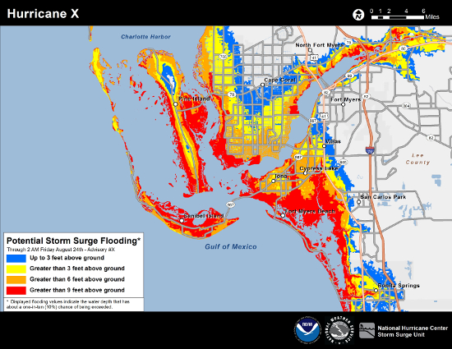


4.1. Do you want the “worst-case scenatio”?
Let’s assume two port cities, A and B
A
Combining worst-case for each point
Alart！
B
Alart！
Ensemble prediction
[NOAA NHC https://www.nhc.noaa.gov/experimental/inundation/]
Note that the worst-cases for A and B never happens at the same time!
To consider large-scale (or nationwide) operation for pre and post disaster management, more realistic worst cases are required.

Slide 24
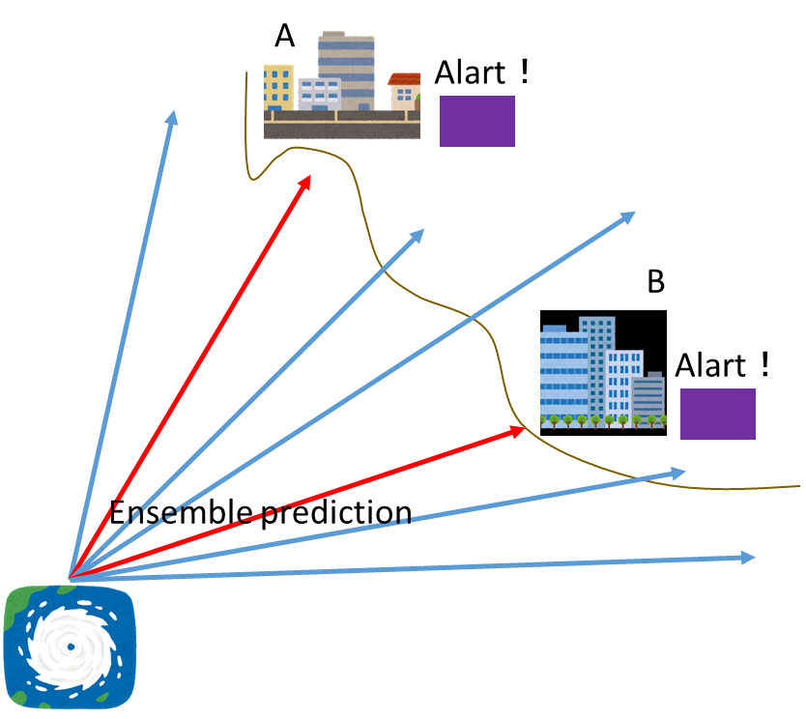
4.2. Key idea: Pareto frontier analysis
Ensemble members are plotted in 2-D graph according to their storm surge hazard
S is not Pareto dominant to u
(s is severe in B but not in A)
u
S
S is Pareto dominant to t
(s is severe in both A and B)
Storm surge hazard in A
t
Pareto frontier
= Set that we should check as the worst case.
Storm surge hazard in B

Slide 25
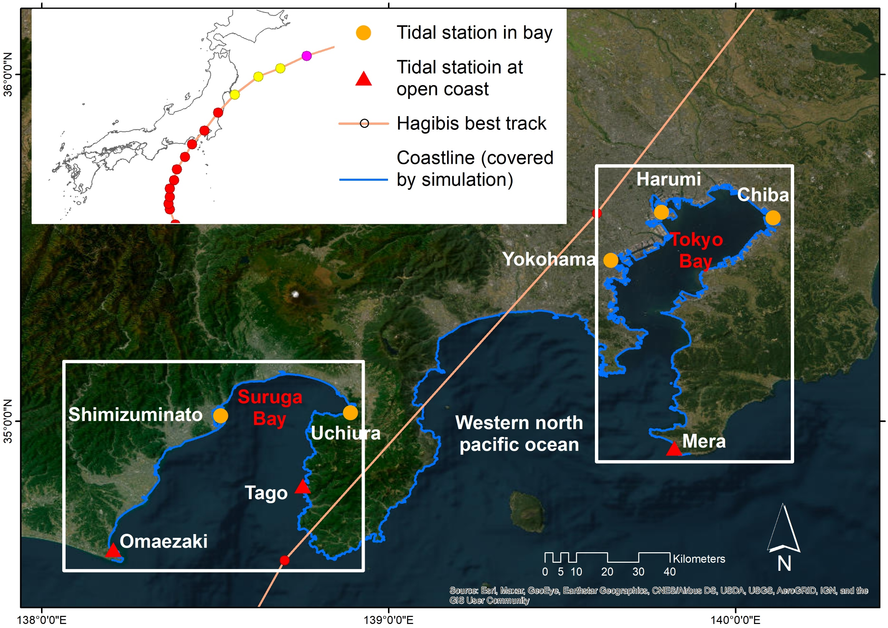
4.3. Case study
2019 TC Hagibis
Combining meteorological and storm surge model, surge height is simulated by 1000 ensembles
Atmospheric model: JMA-NHM [Saito et al. 2006]
Ensemble method: EnVAR [Duc et al. 2021]
Storm surge model: SSHPI [Islam et al. 2021]

Slide 26
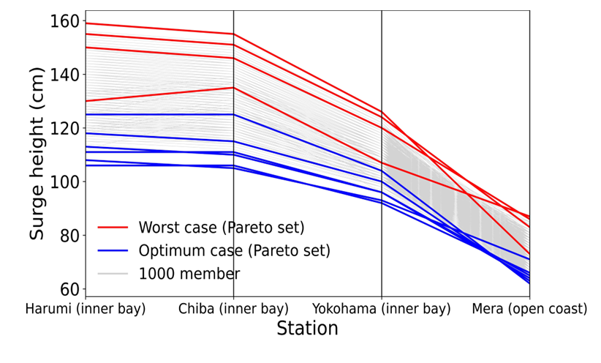
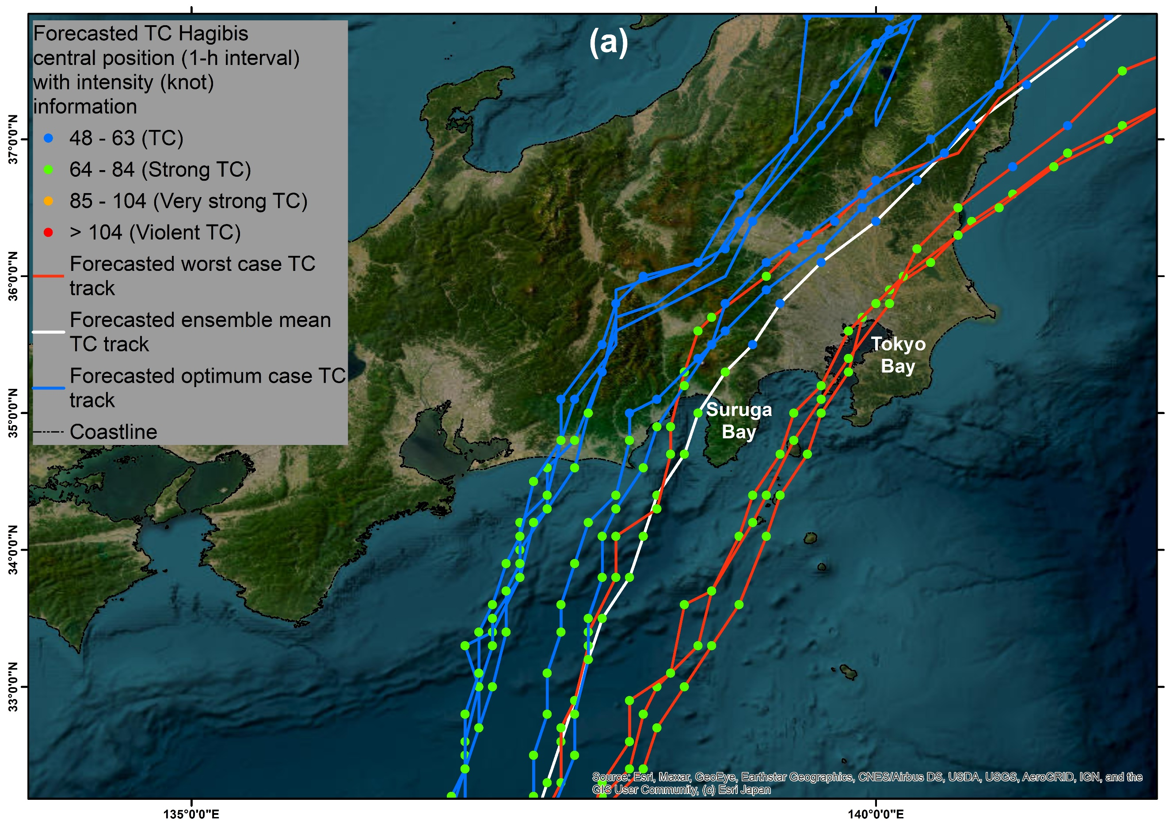
4.4. Pareto frontier of storm surge risk in Tokyo bay
Surge height in 4 points in Tokyo
Red: Pareto frontier of highest cases
Blue: Pareto frontier of lowest cases
Track forecast
White : ensemble mean
Red: Pareto frontier of highest cases
Blue: Pareto frontier of lowest cases
→ We successfully get 4 “realistic” worst scenario from 1000 members

Slide 27
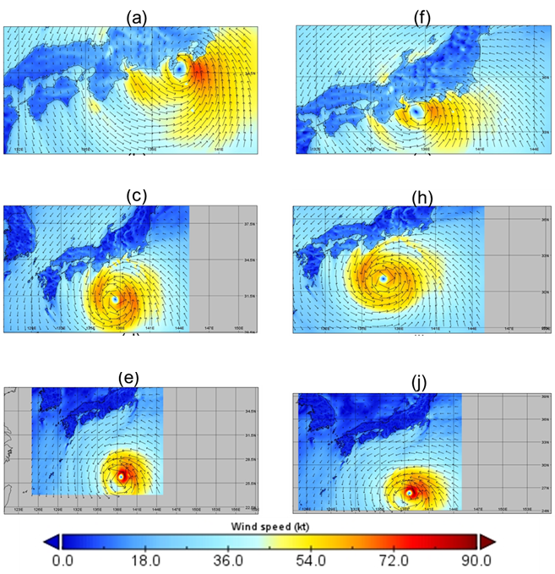
4.5. Pareto frontier of storm surge risk in Tokyo bay
Composite analysis of wind field
Left: Pareto frontier of highest cases
Blue: Pareto frontier of lowest cases
landfall
-12h
-24h

Slide 28
5. Summary
Challenge 1
How to generate “good” ensemble by explicitly considering all the relevant uncertainties in an efficient way?
→ It is possible to explicitly consider parametric and model selection uncertainties for better ensemble generation.
All the ensemble could not capture observation very well…
Challenge 2
How to effectively use ensemble in an operational timeframe?
We can use ensemble “mean” under new definition of distance.
Pareto optimality is useful to extract realistic worst-case scenario from large ensemble data
ensemble mean?
Scenario analysis?

Slide 29

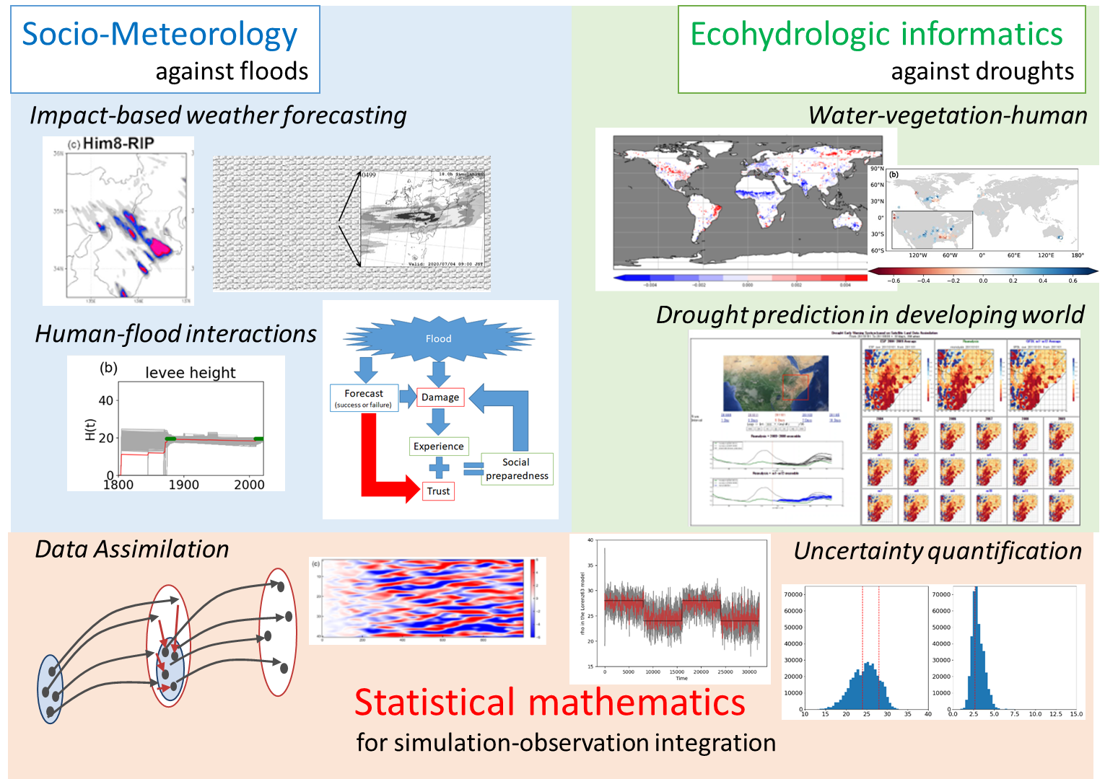

6. Sawada Group at the University of Tokyo (Department of Civil Engineering)
“Mathematical Hydrological Disaster Science Group”
Yohei Sawada
Associate Professor
Le Duc
Assistant Professor
https://sites.google.com/view/sawadaresearchgroup/home
Any collaborations are highly welcome!

Slide 30
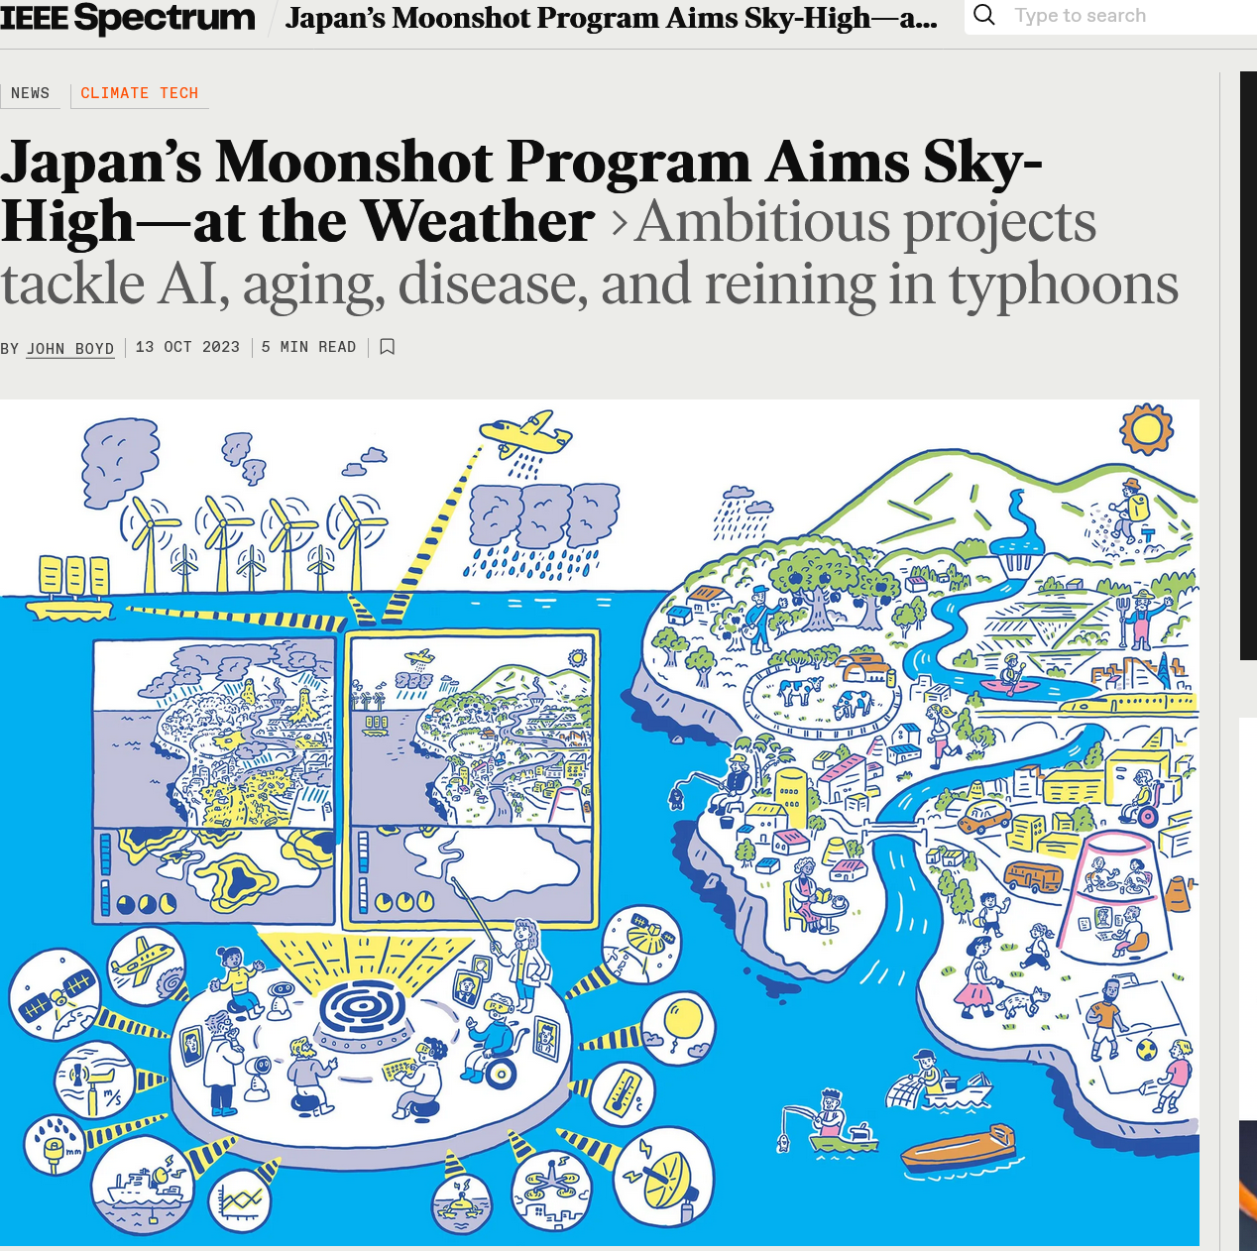
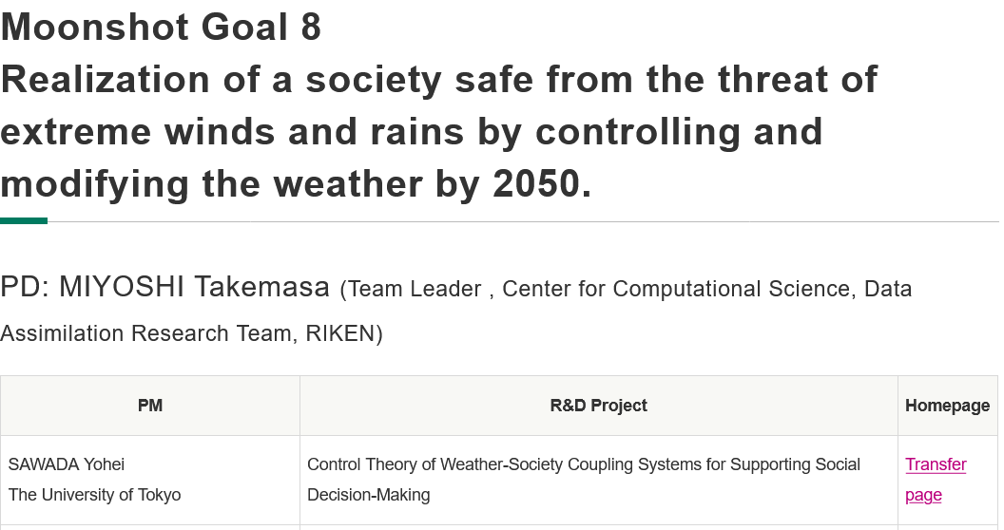
7. Japan’s new program to discuss the controllability of tropical cyclones
Japanese government launched the new R&D program to pursue weather controllability. This program includes many other social issues, such as international agreement.
Any comments/collaborations are welcome!
https://spectrum.ieee.org/weather-control-japan-moonshot

